Slide 1

IMPLEMENTATION OF SPEECH ENHANCeMENT ALGORITHMS
Ali Umut Kaypak – Melih Baştürk – Egemen Erbayat

Slide 2
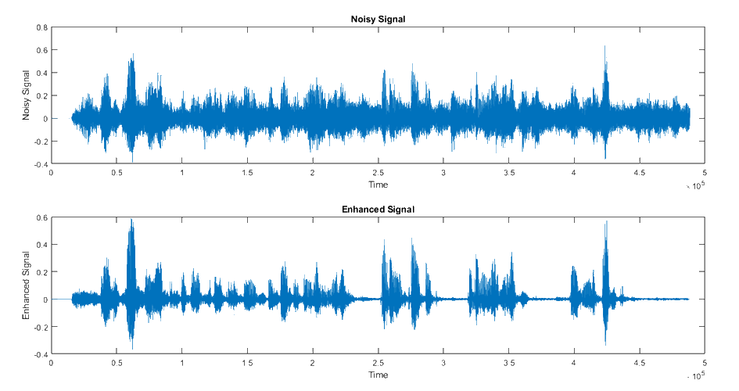
PURPOSE OF THE PROJECT
Implementing state-of-art speech enhancement algorithms to improve the speech which suffers from degradations and noises is the purpose of this project

Slide 3
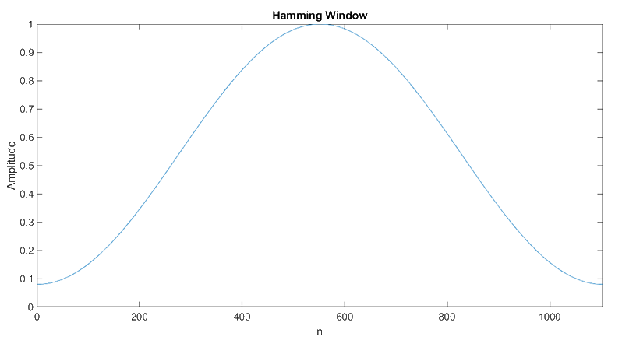
FRAMING

Slide 4
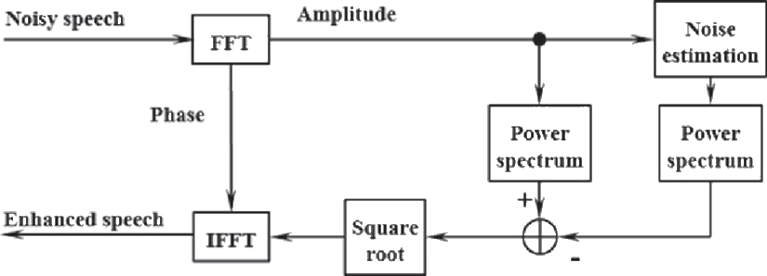


SPECTRAL SUBSTRACTION
$y\left(n\right)=s\left(n\right)+d\left(n\right)$
(1)
(2)
$${\left.​\right|S}_{m}\left(w\right){\left.​\right|}^{2}={\left|Y\right.}_{m}\left(w\right){\left.​\right|}^{2}−β ×\hat{\left|D_{m}\right.}\left(w\right){\left.​\right|}^{2}$$
Source: [1]
(3)

Slide 5
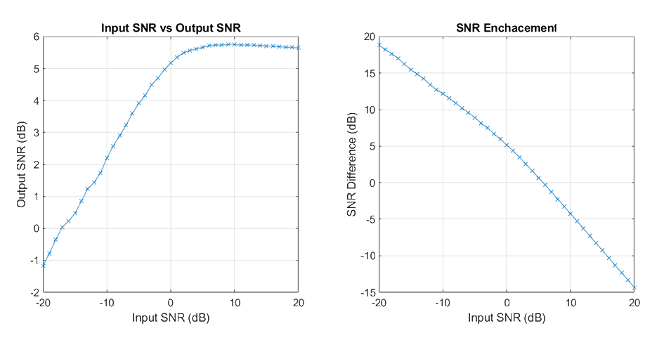
SPECTRAL SUBSTRACTION

Slide 6
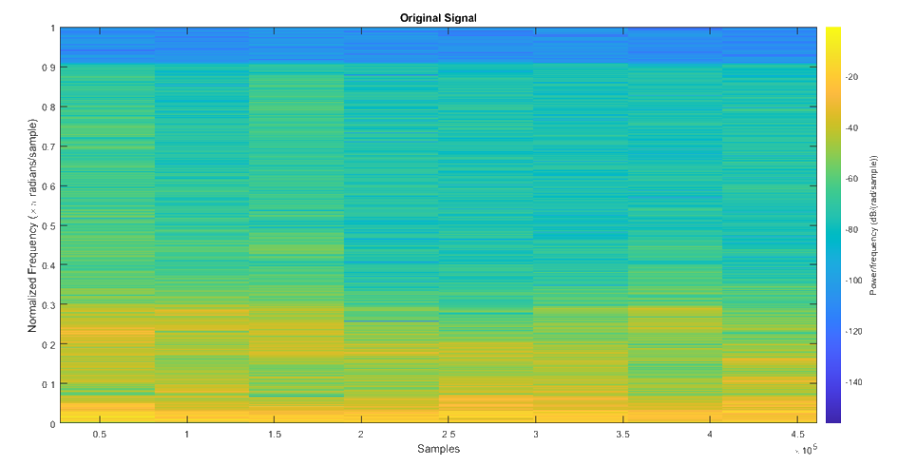
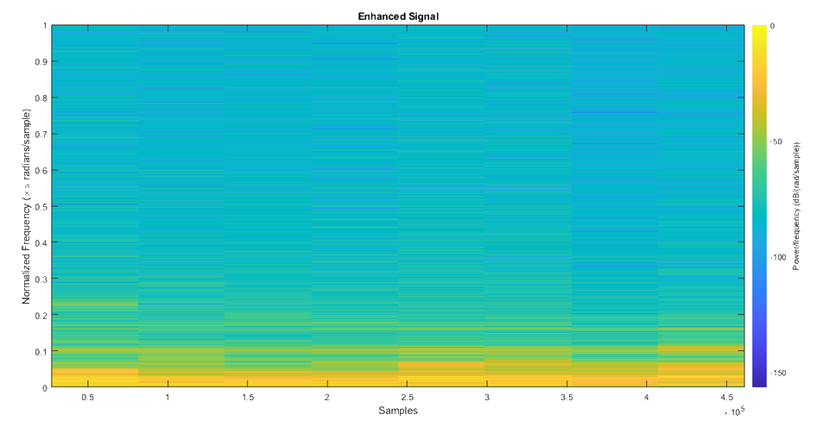
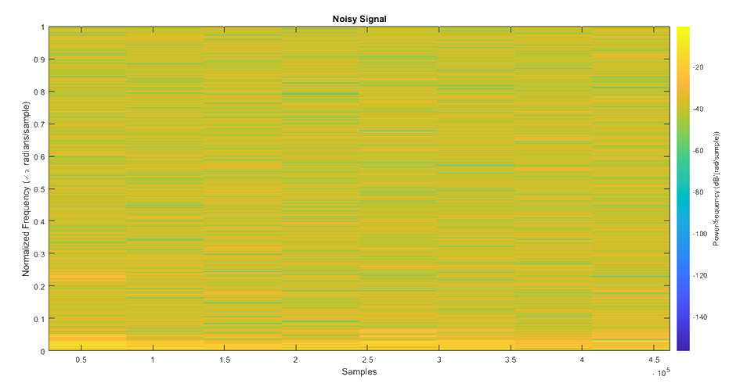
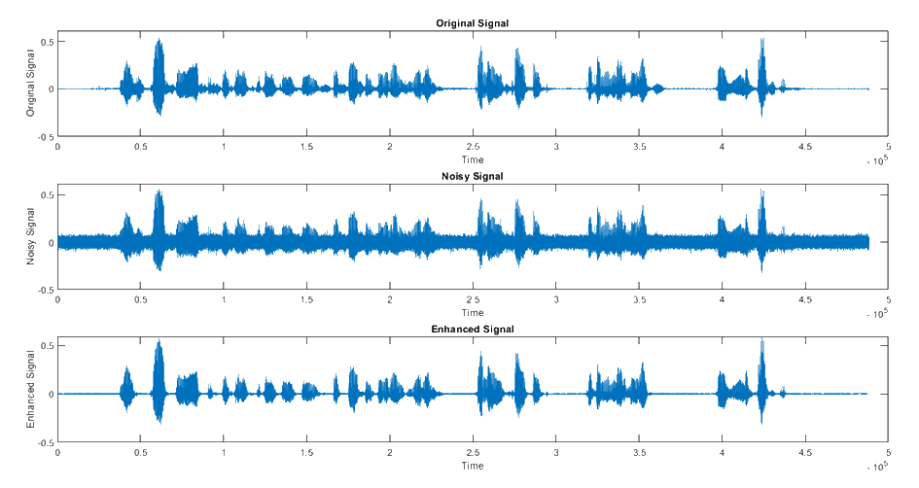
SPECTRAL SUBSTRACTION

Slide 7
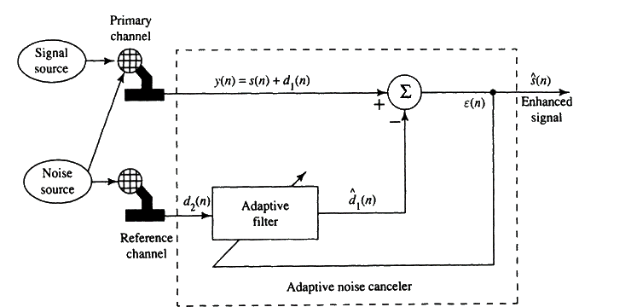
ADAPTIVE NOISE CANCELLING
Source: [1]

Slide 8
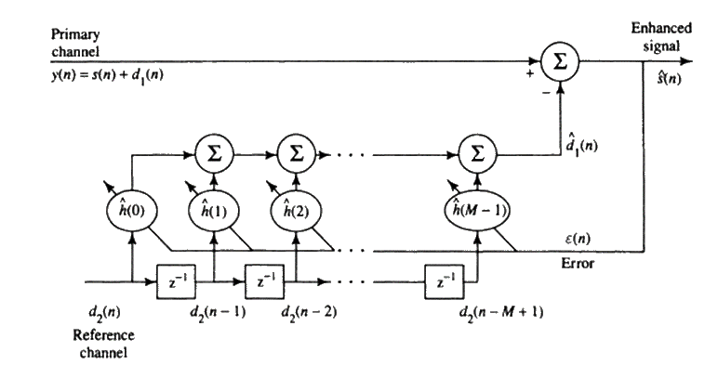

ADAPTIVE NOISE CANCELLING
(1)
$$h_{n+1}=h_{n}+2×μ×\left(\hat{s\left(n\right) }×\hat{d_{1}}\left(n\right)\right)$$
(2)
Source: [1]

Slide 9
ADAPTIVE NOISE CANCELLING

Slide 10
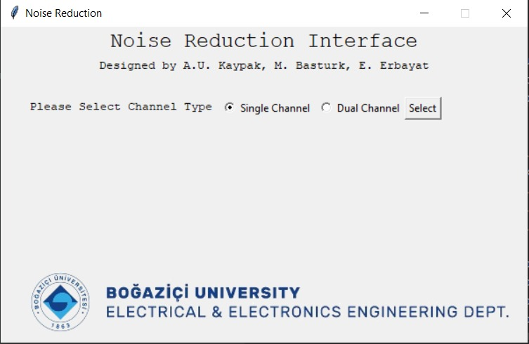
USER INTERFACE

Slide 11
REFERENCES
[1] Deller Jr, John R., John G. Proakis, and John H. Hansen. Discrete time processing of speech signals. Prentice Hall PTR, 1993.
[2] J. Allen, "Short term spectral analysis, synthesis, and modification by discrete Fourier transform," in IEEE Transactions on Acoustics, Speech, and Signal Processing, vol. 25, no. 3, pp. 235-238, June 1977, doi: 10.1109/TASSP.1977.1162950.
[3]S. Boll, "Suppression of acoustic noise in speech using spectral subtraction," in IEEE Transactions on Acoustics, Speech, and Signal Processing, vol. 27, no. 2, pp. 113-120, April 1979, doi: 10.1109/TASSP.1979.1163209.]
[4] B. Widrow et al., "Adaptive noise cancelling: Principles and applications," in Proceedings of the IEEE, vol. 63, no. 12, pp. 1692-1716, Dec. 1975, doi: 10.1109/PROC.1975.10036.
[5] W. G. Knecht, M. E. Schenkel and G. S. Moschytz, "Neural network filters for speech enhancement," in IEEE Transactions on Speech and Audio Processing, vol. 3, no. 6, pp. 433-438, Nov. 1995, doi: 10.1109/89.482210.
[6] Lukin, Alexey and Jeremy G. Todd. "Suppression of Musical Noise Artifacts in Audio Noise Reduction by Adaptive 2-D Filtering." Journal of The Audio Engineering Society (2007)

